Slide 1
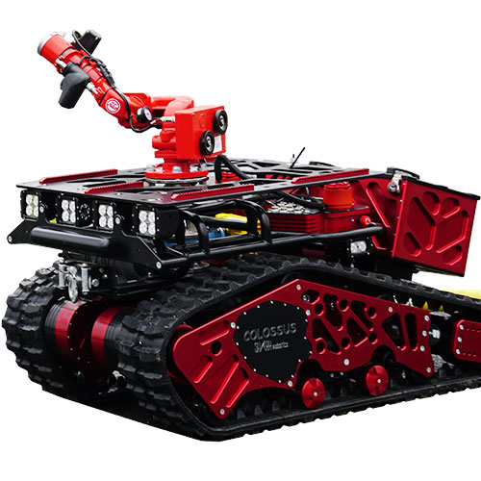
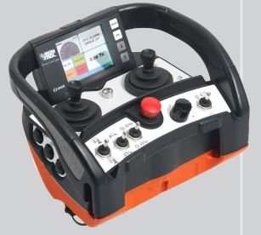
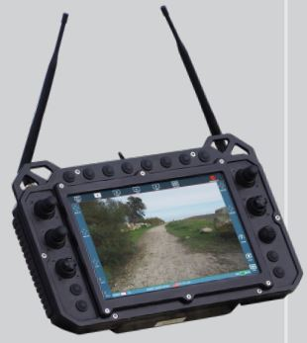
Colossus by Shark Robotics (France)
Power Supply
6 lithium-ion batteries (14S8P - 48V - 27AH)
Camera/Sensor
Zoom X 30 Thermal Camera
Motion
7 km/h
Climbing angle: Slope - up to 40° / Side slope - up to 35°
Obstacle clearance: Up to 30 cm
Water Supply
3000 litres/m
Transmission Distance
IK-Shark (300 m at sight)
GCS-Shark (500 m at sight)
Features
Resistant to heat waves (up to 900°C)
Configuration (Optional)
Long Distance Transmission: Mesh Relay Option
Sensors Tray: CBRN, gas
Extra batteries
Control camera on the front
Connection cable
Colossus
IK-Shark
GCS-Shark
(https://www.youtube.com/watch?v=9v7wm7wm3LQ&ab_channel=SharkRobotics)

Slide 2
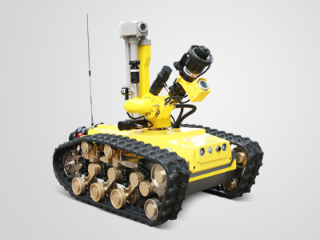
RXR-MC80JD by CITIC Group (China)
Power Supply
Lithium Battery
Camera/Sensor
Yes
Water Supply
Spray type: water / foam
Spraying mode: rotation / pitching
Drag two 60 m water hoses
Transmission Distance
1 km
Features
Automatic sprinkling cooling system
Configuration (Optional)
Internet connection
Environment acquisition for gas detection
Heat eye detection
Remote hose drop
Sound and image collection
RXR-MC80JD
(https://www.youtube.com/watch?v=WcnjsTzNn8o&ab_channel=CITICHICKaichengIntelligenceEquipmentCo.%2CLtd.)

Slide 3
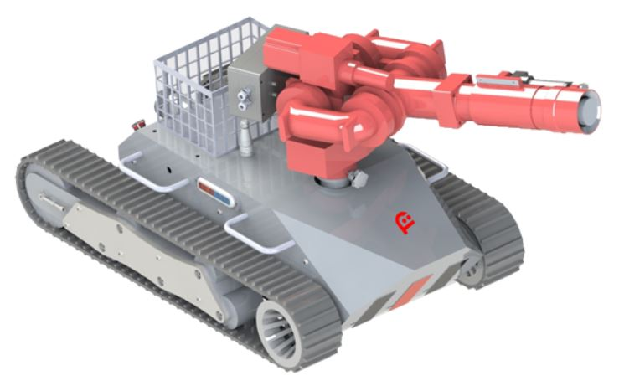
RXR-M30D-13 by fourobot (China)
Power Supply
Battery Pack
Camera/Sensor
Not Stated
Motion
1 m/s
Climbing angle: Slope - up to 30°
Water Supply
30 litres/s
Max reach: 40 m
Spray type: waterspout / water mist
Transmission Distance
200 m
Configuration (Optional)
Self cooling
Multifunction bucket
Communication support
Light Alarm
Rescue cart
RXR-M30D-13
(https://www.youtube.com/watch?v=R0OZ7XqpFys&ab_channel=FOUROBOT)

Slide 4
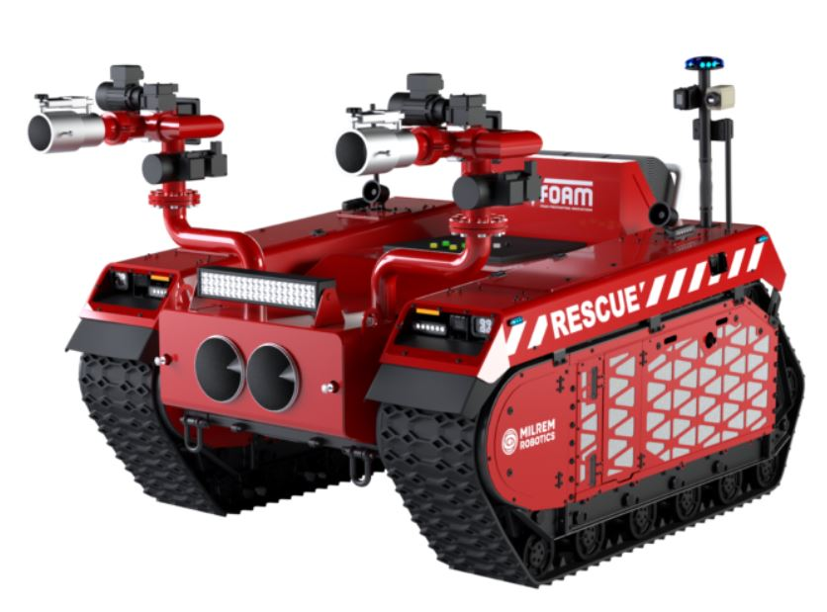
Multiscope Rescue with Hydra by Milrem Robotics (Estonia)
Power Supply
Battery Pack (Lead acid / Li-ion) / Diesel engine & electric generator
Camera/Sensor
Not Stated
Motion
20 km/h
Climbing angle: Slope - up to 30°
Ground clearance: 40 - 60 cm
Water Supply
3000 litres/m
Max reach: 62 m
Spray type: water / foam
Drag four water hose
Transmission Distance
Not Stated
Features
Two fire monitors able to rotate 360°
Two cooling sprinkles to protect vehicle
Multiscope Rescue with Hydra
(https://youtu.be/5cdtOLt93XA)

Slide 5
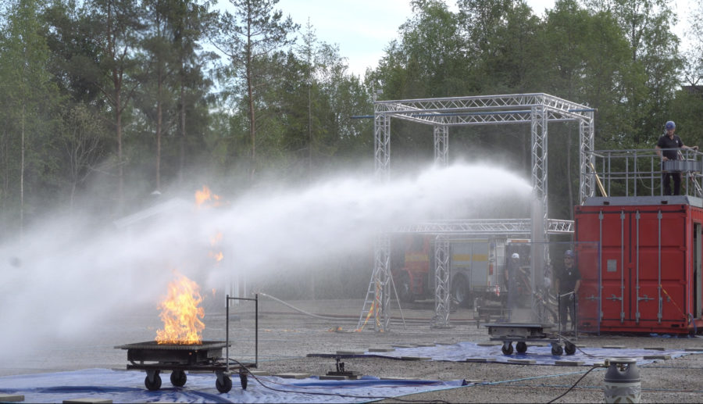
FlameRanger by UniFire (Sweden)
Camera/Sensor
Tyco FV311: detect x, y coordinates up to 4 fires
FireTIR: detect heat before there is a fire
Water Supply
Spray type: water / foam
FORCE 50:
2200 litres/min
Max reach: 65 m
FORCE 80:
5500 litres/min
Max reach: 85 m
Features
Full 360° horizontal rotation and full 180° vertical movement for water cannon
Manual Remote Control (Industrial remote, Smartphone App, CANbus Joystick, PC interfaces)
Configuration (Optional)
Swing Arms
Extending Boom
Mounting Pipes
Valve & Actuator
Robotic Platform
Customized GUIs
FlameRanger
(https://www.youtube.com/watch?v=WOfYgSxrVzM&t=36s&ab_channel=UnifireAB)

